Slide 1
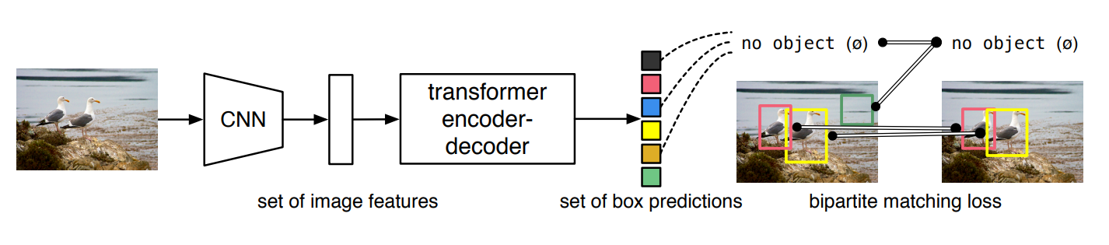
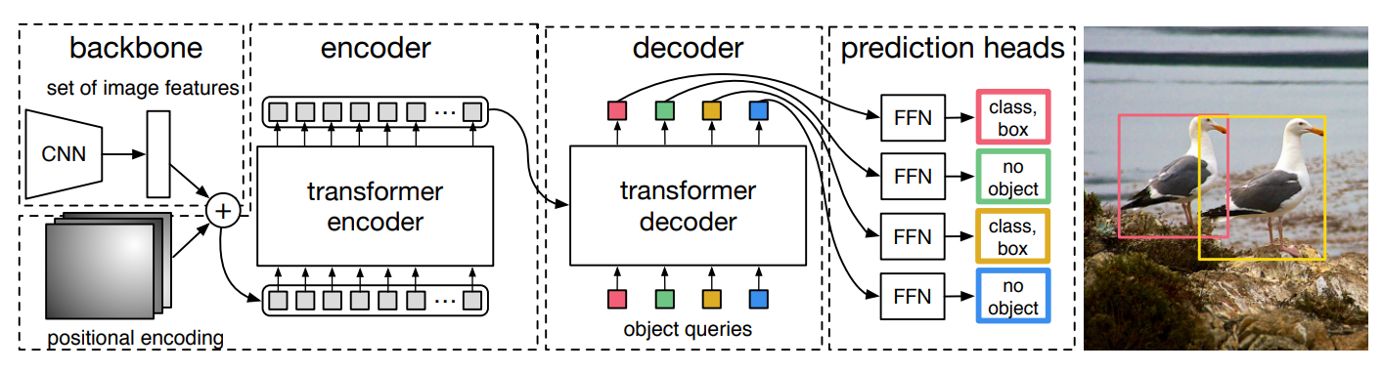
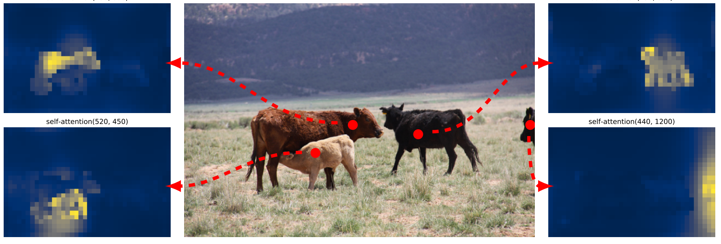
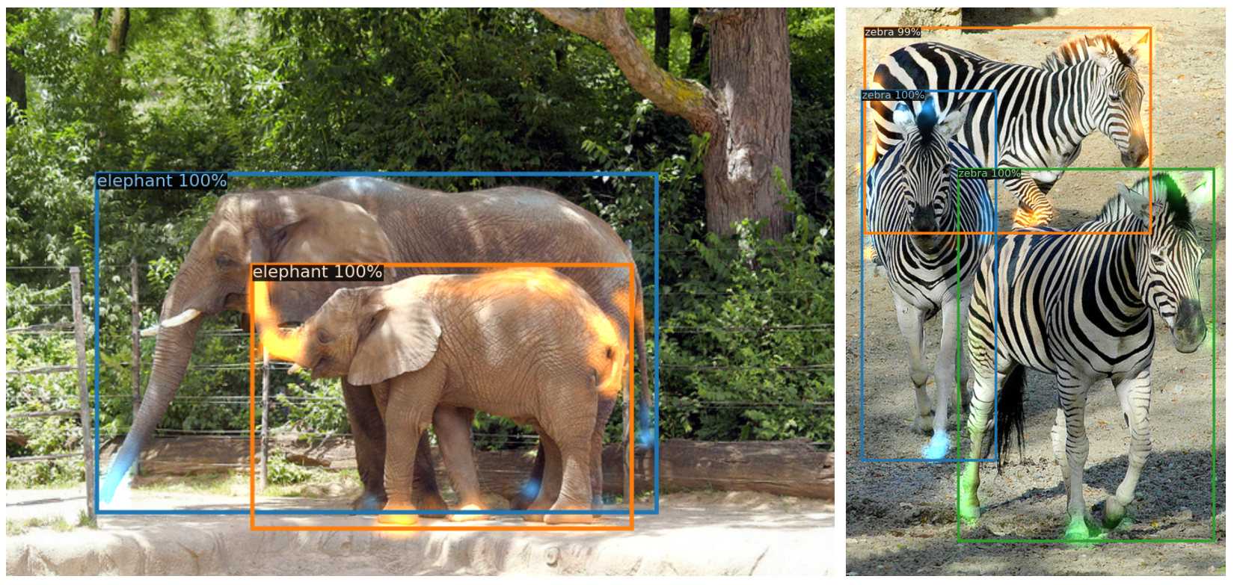
DETR-series object detection----based on which I intend to conduct some experiments
Carion, Nicolas, et al. "End-to-end object detection with transformers." Computer Vision–ECCV 2020: 16th European Conference, Glasgow, UK, August 23–28, 2020, Proceedings, Part I 16. Springer International Publishing, 2020.

Slide 2
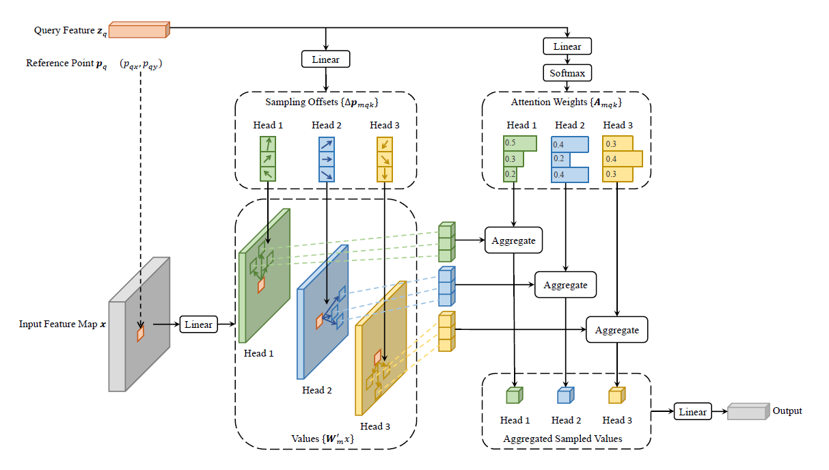
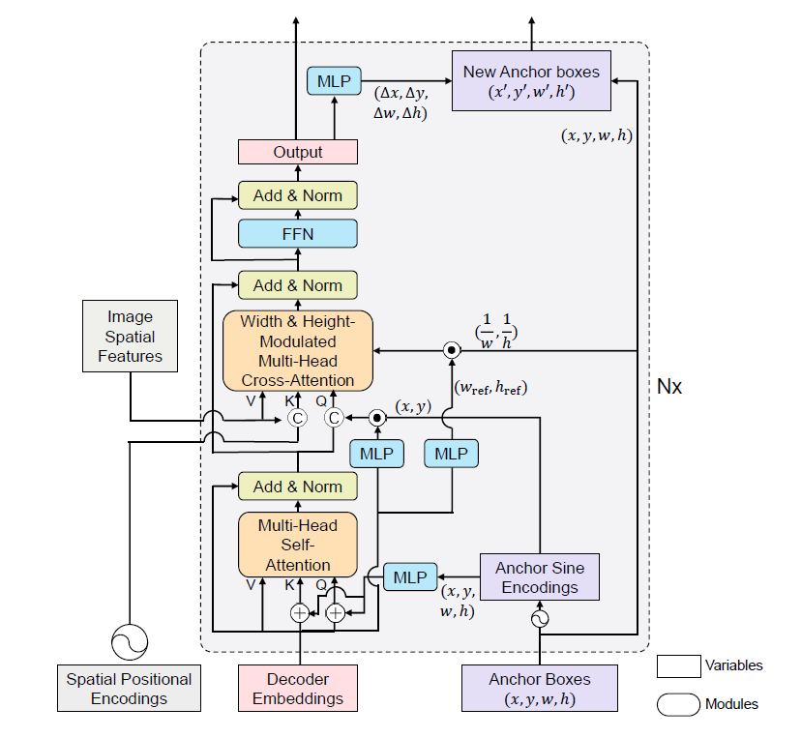
Deformable DETR
DAB-DETR
Zhu, Xizhou, et al. "Deformable detr: Deformable transformers for end-to-end object detection." arXiv preprint arXiv:2010.04159 (2020).
Liu, Shilong, et al. "Dab-detr: Dynamic anchor boxes are better queries for detr." arXiv preprint arXiv:2201.12329 (2022).

Slide 3
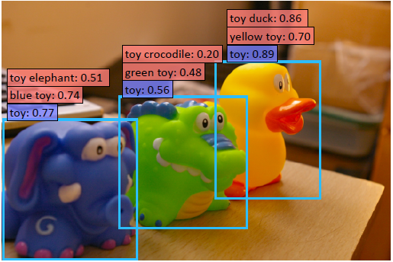
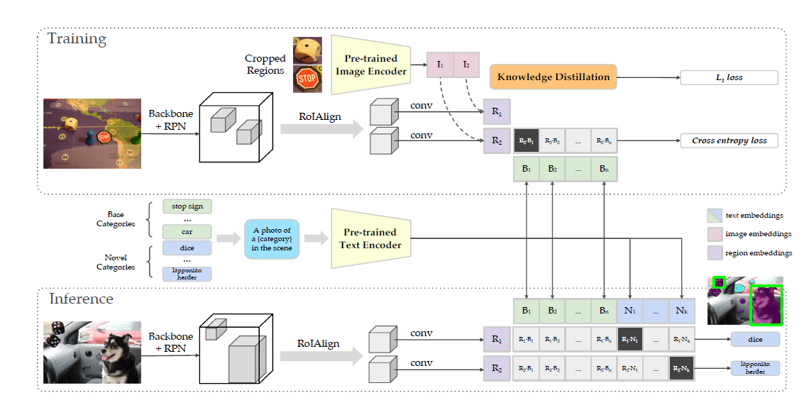
Open-set recognition
Gu, Xiuye, et al. "Open-vocabulary object detection via vision and language knowledge distillation." arXiv preprint arXiv:2104.13921 (2021).

Slide 4
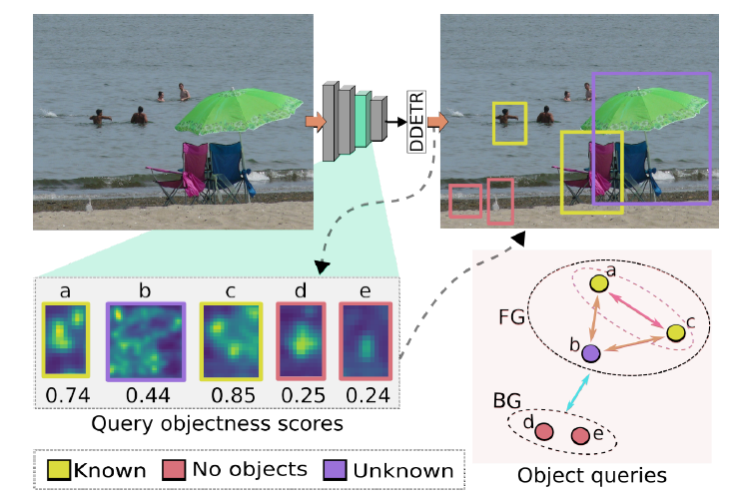
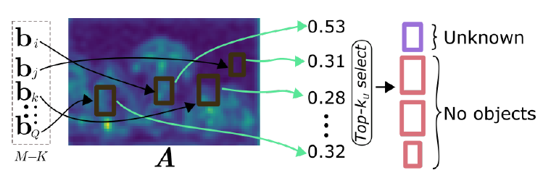
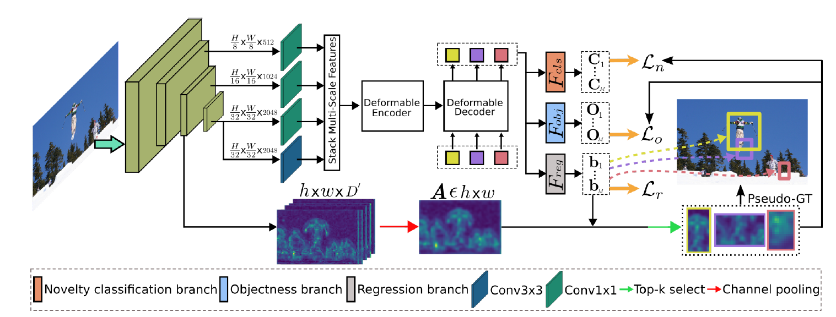
Gupta, Akshita, et al. "Ow-detr: Open-world detection transformer." Proceedings of the IEEE/CVF Conference on Computer Vision and Pattern Recognition. 2022.

Slide 5
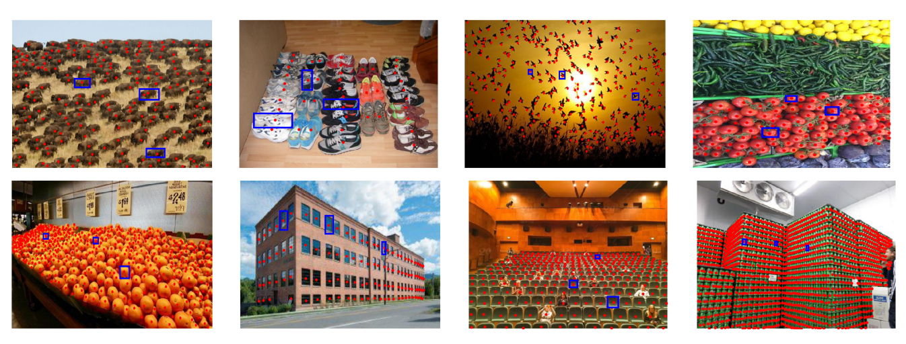
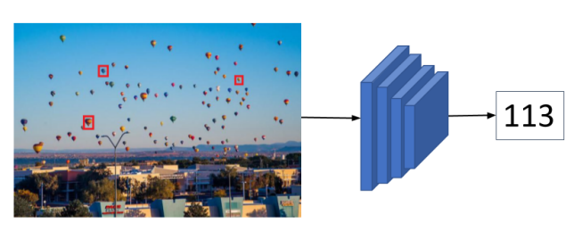
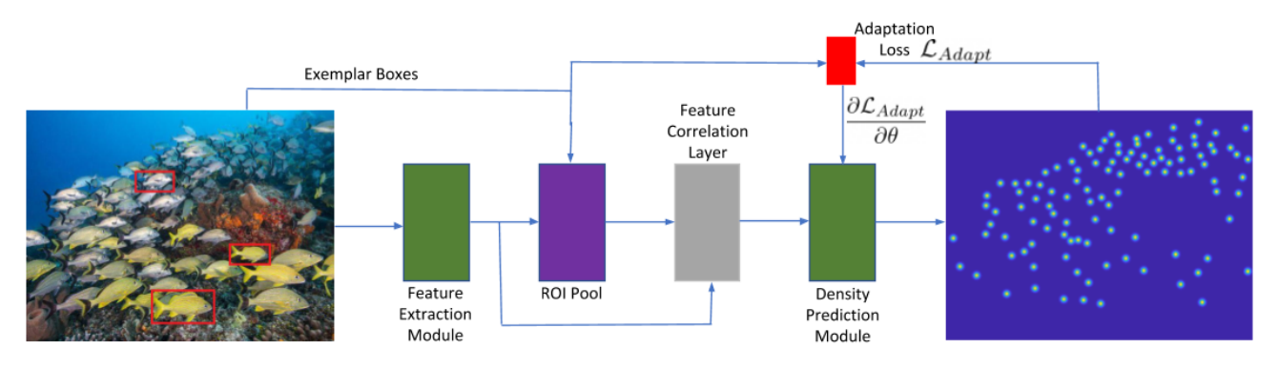
Class agnostic vision tasks(visual counting, pose estimation, etc.)
Ranjan, Viresh, et al. "Learning to count everything." Proceedings of the IEEE/CVF Conference on Computer Vision and Pattern Recognition. 2021.

Slide 6
The topics I am studying:
Vision/multi-modality foundation model
Reinforcement Learning and Multi-agent Reinforcement Learning
Machine Learning with Graphs
AIGC
Federated Learning(Personalization, trustworthy FL)
etc.

